Slide 1




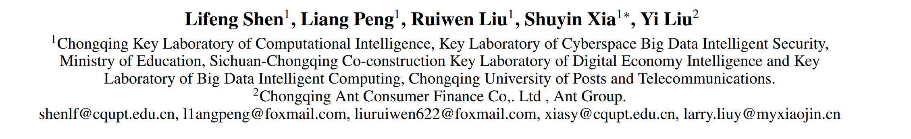



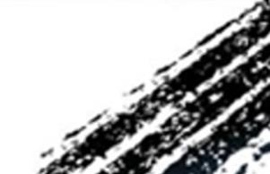

ATAI
Advanced Technique of Artificial Intelligence
ATAI
ChongqingUniversity _{AdvancedTechniqueof}
of Technology Artificial Intelligence
Chongqing University of
Technology
Chongqing University ^{ATAI}
_{of Technology} Advanced Techniqueof
Artificial Intelligence
Chongqing University of Technology
Chongqing University of Technology
Finding Time Series Anomalies
Using Granular-Ball Vector Data Description
Code: https://github.com/notshine/GBOC
—AAAI 2026
Reported by Cong Sheng
1

Slide 2
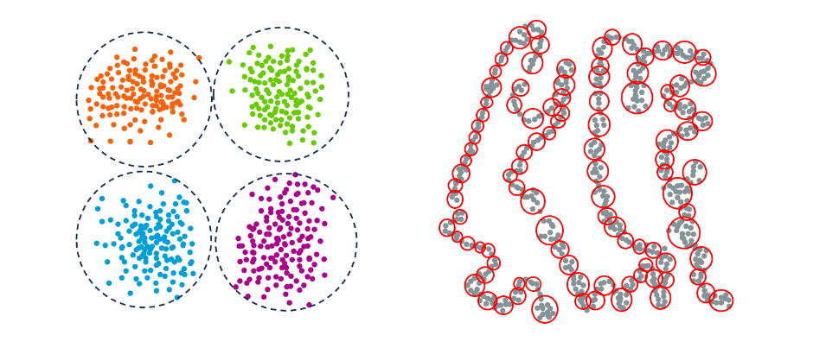
ATAI
Advanced Technique of Artificial Intelligence
ATAI
ChongqingUniversity _{AdvancedTechniqueof}
of Technology Artificial Intelligence
Chongqing University of
Technology
Chongqing University ^{ATAI}
_{of Technology} Advanced Techniqueof
Artificial Intelligence
Chongqing University of Technology
Chongqing University of Technology
Motivation
Modeling normal behavior in dynamic and nonlinear time series data is challenging for effective anomaly detection. Traditional methods, such as nearest neighbor and clustering methods, usually rely on strict assumptions, such as the number of predefined reliable neighbors or clusters, which often fail in complex temporal scenarios.
For example, the clustering-based method assumes clearly defined boundaries, which is not suitable for the typical continuous and boundaryless distribution of time series data, and requires a more adaptive description method.

Slide 3
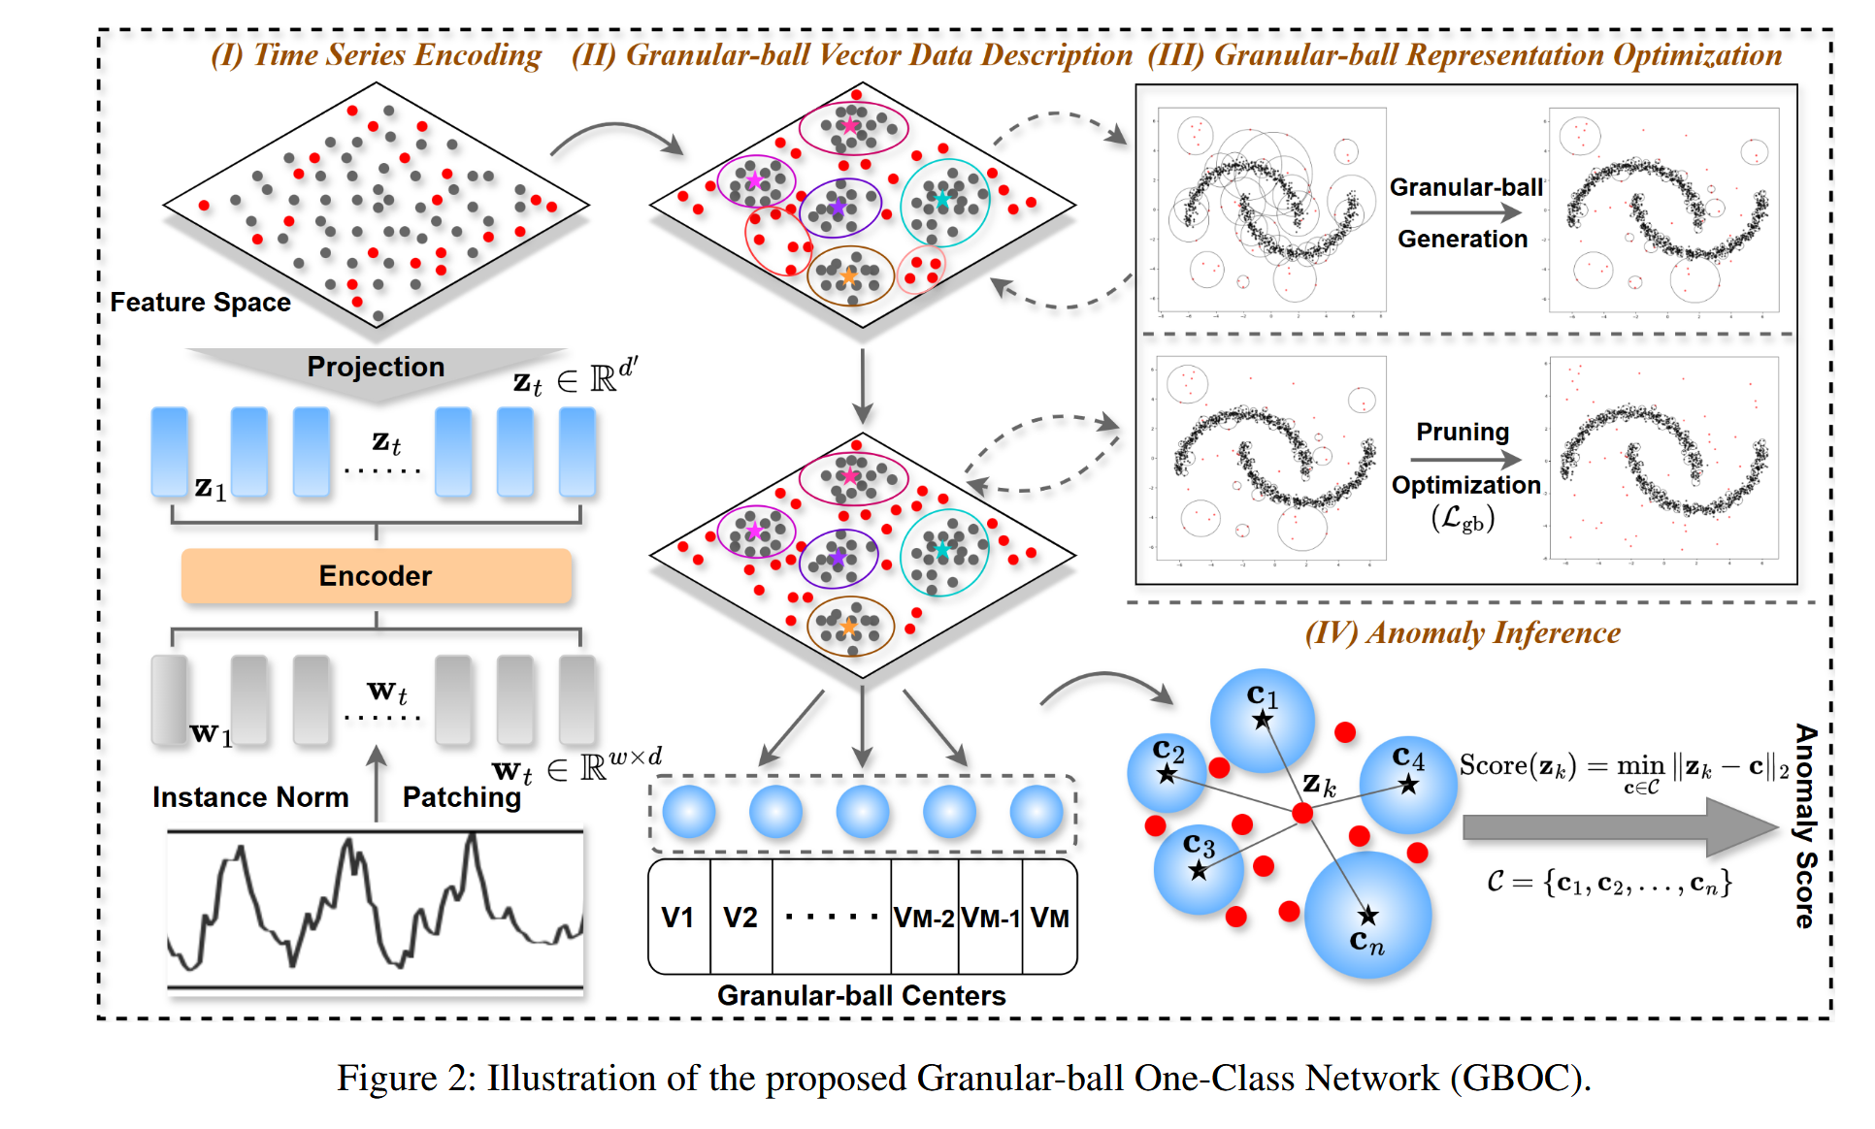
ATAI
Advanced Technique of Artificial Intelligence
ATAI
ChongqingUniversity _{AdvancedTechniqueof}
of Technology Artificial Intelligence
Chongqing University of
Technology
Chongqing University ^{ATAI}
_{of Technology} Advanced Techniqueof
Artificial Intelligence
Chongqing University of Technology
Chongqing University of Technology
Overview

Slide 4




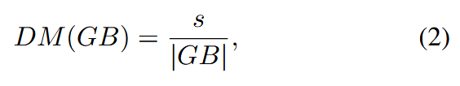
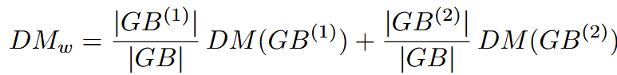

ATAI
Advanced Technique of Artificial Intelligence
ATAI
ChongqingUniversity _{AdvancedTechniqueof}
of Technology Artificial Intelligence
Chongqing University of
Technology
Chongqing University ^{ATAI}
_{of Technology} Advanced Techniqueof
Artificial Intelligence
Chongqing University of Technology
Chongqing University of Technology
Method

Slide 5




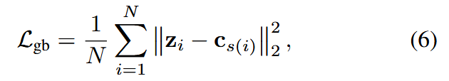

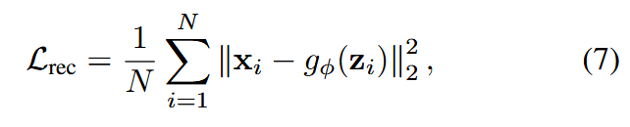


ATAI
Advanced Technique of Artificial Intelligence
ATAI
ChongqingUniversity _{AdvancedTechniqueof}
of Technology Artificial Intelligence
Chongqing University of
Technology
Chongqing University ^{ATAI}
_{of Technology} Advanced Techniqueof
Artificial Intelligence
Chongqing University of Technology
Chongqing University of Technology
Method

Slide 6
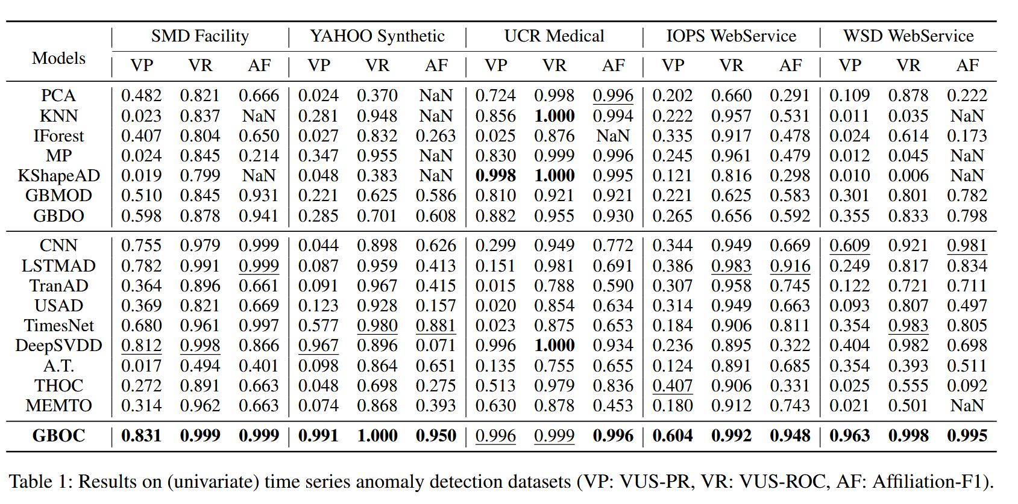
ATAI
Advanced Technique of Artificial Intelligence
ATAI
ChongqingUniversity _{AdvancedTechniqueof}
of Technology Artificial Intelligence
Chongqing University of
Technology
Chongqing University ^{ATAI}
_{of Technology} Advanced Techniqueof
Artificial Intelligence
Chongqing University of Technology
Chongqing University of Technology
Experiments

Slide 7
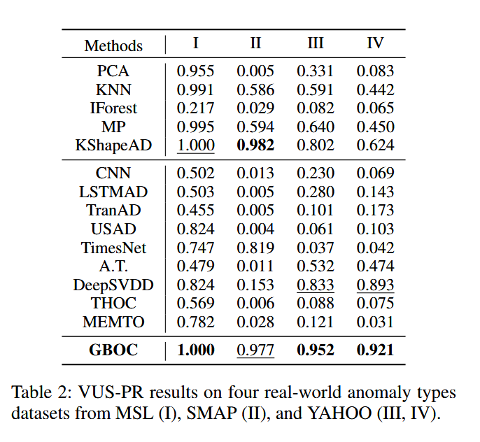
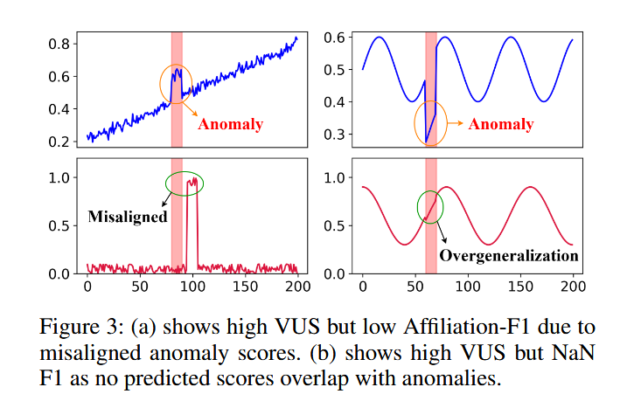
ATAI
Advanced Technique of Artificial Intelligence
ATAI
ChongqingUniversity _{AdvancedTechniqueof}
of Technology Artificial Intelligence
Chongqing University of
Technology
Chongqing University ^{ATAI}
_{of Technology} Advanced Techniqueof
Artificial Intelligence
Chongqing University of Technology
Chongqing University of Technology
Experiments

Slide 8

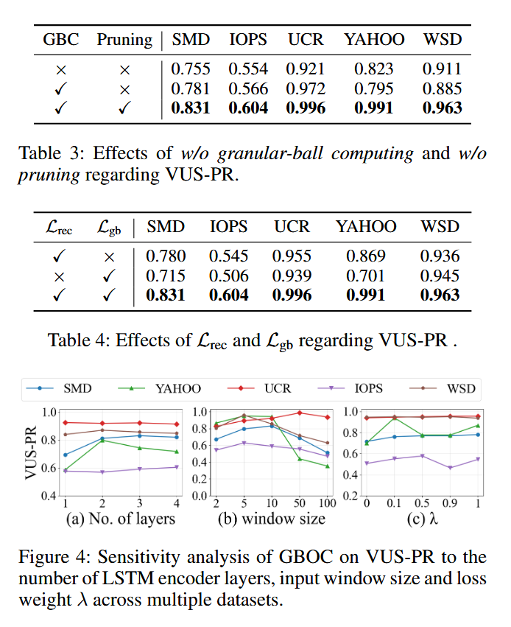
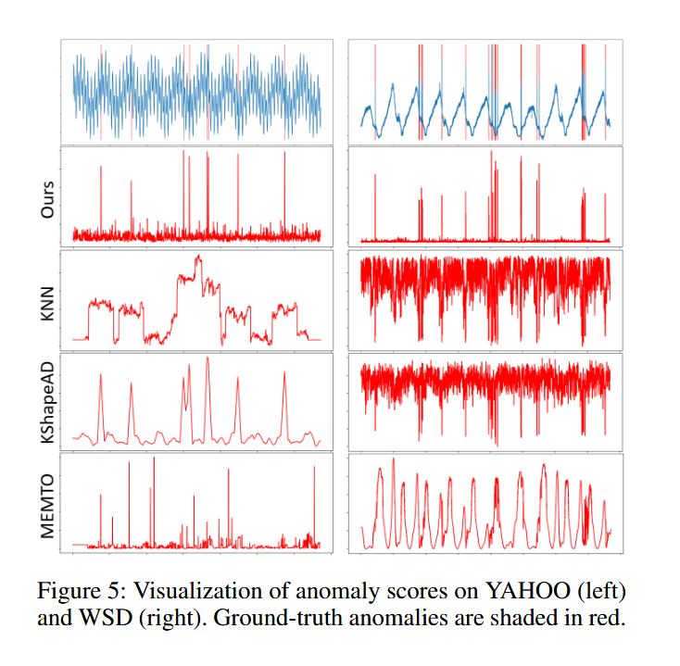
ATAI
Advanced Technique of Artificial Intelligence
ATAI
ChongqingUniversity _{AdvancedTechniqueof}
of Technology Artificial Intelligence
Chongqing University of
Technology
Chongqing University ^{ATAI}
_{of Technology} Advanced Techniqueof
Artificial Intelligence
Chongqing University of Technology
Chongqing University of Technology

Slide 9


ATAI
Advanced Technique of Artificial Intelligence
ATAI
ChongqingUniversity _{AdvancedTechniqueof}
of Technology Artificial Intelligence
Chongqing University of
Technology
Chongqing University ^{ATAI}
_{of Technology} Advanced Techniqueof
Artificial Intelligence
Chongqing University of Technology
Chongqing University of Technology
Thanks!

